Slide 1


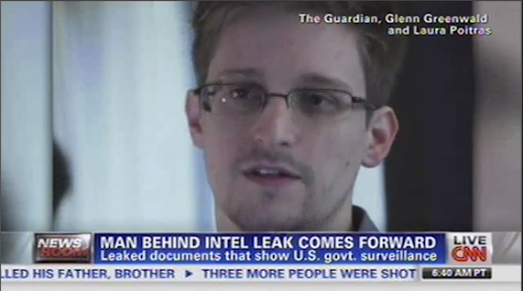


Contextualizing Events in TV News Shows
José Luis Redondo García, Laurens De Vocht, Raphaël Troncy,
Erik Mannens, Rik Van de Walle
{redondo, raphael.troncy}@eurecom.fr
{laurens.devocht, erik.mannens, rik.vandewalle}@ugent.be

Slide 2
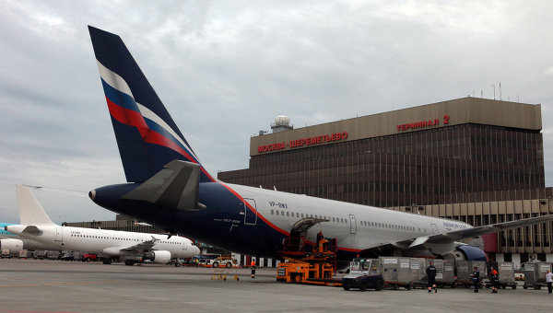
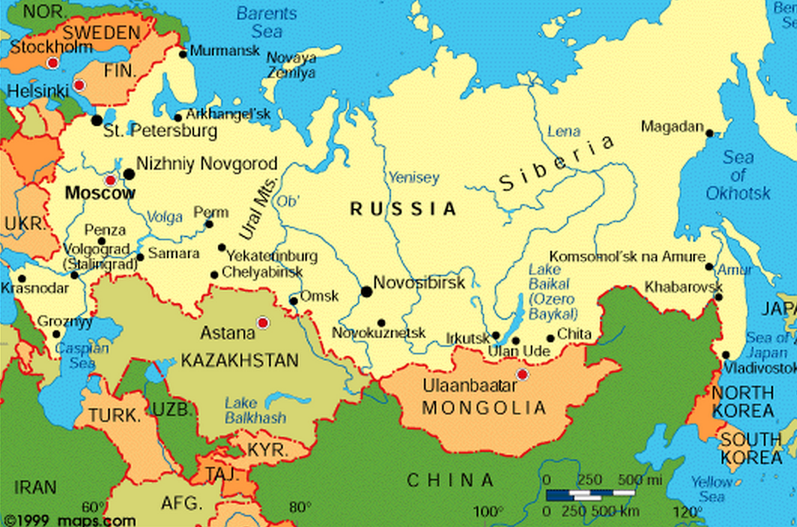
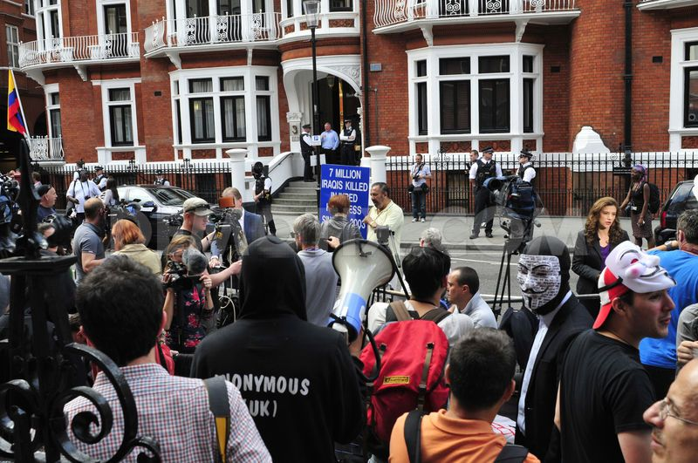
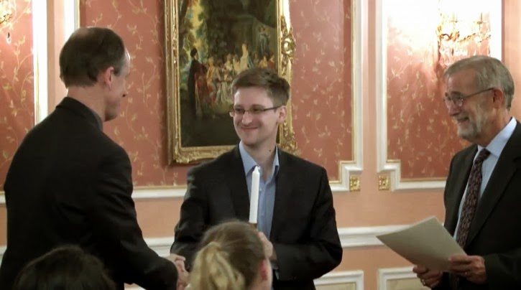
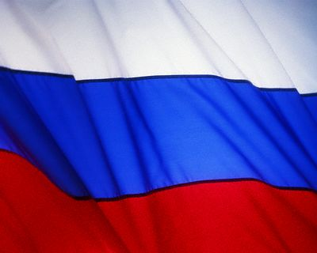


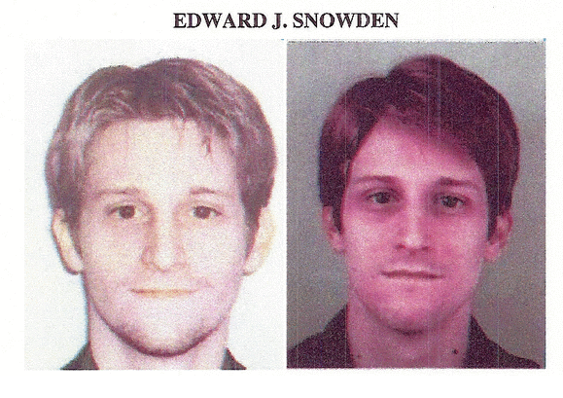
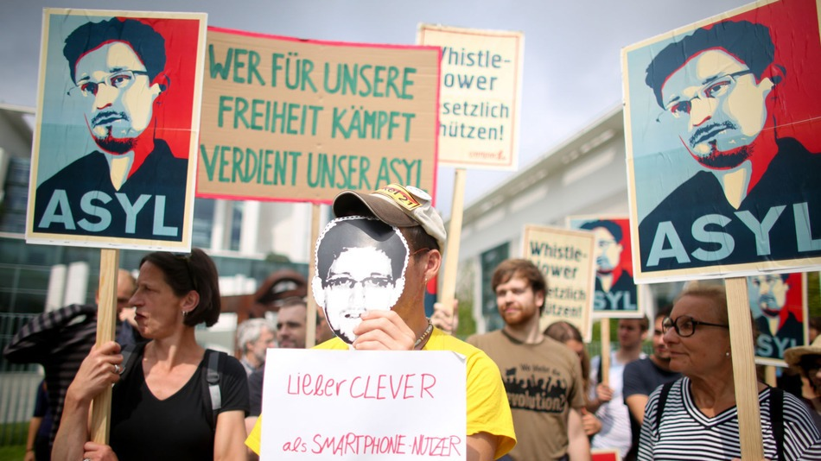
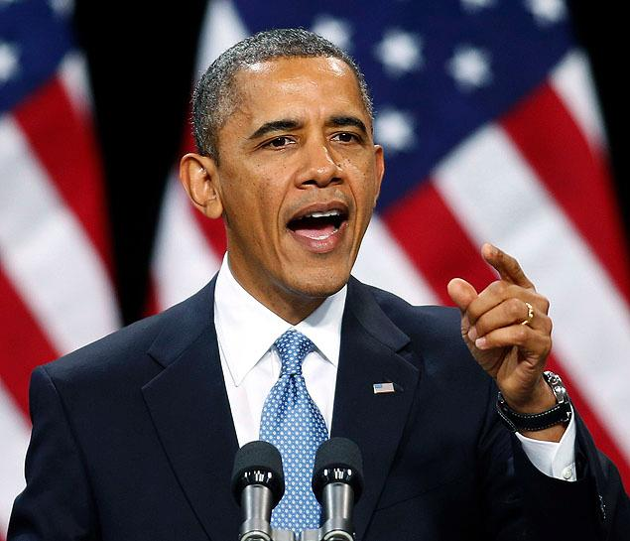
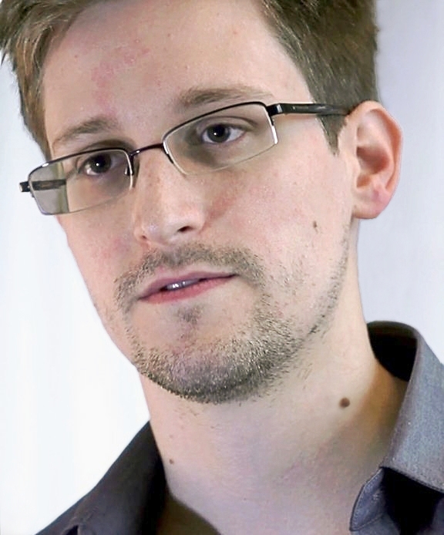
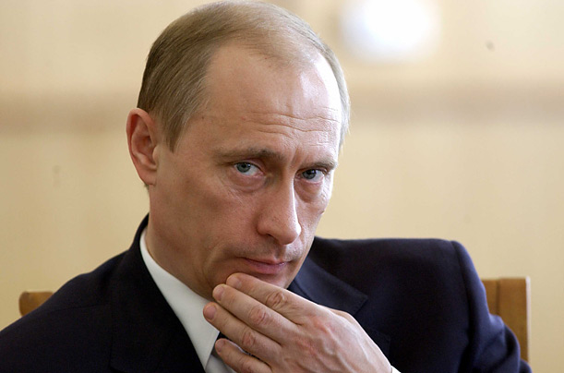
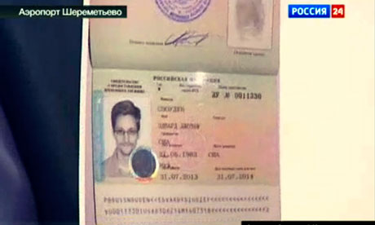

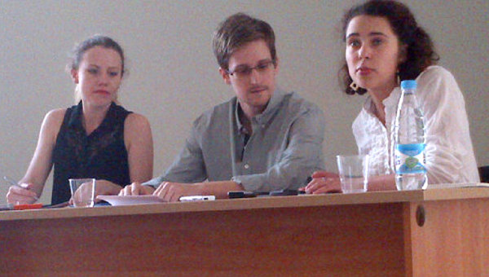
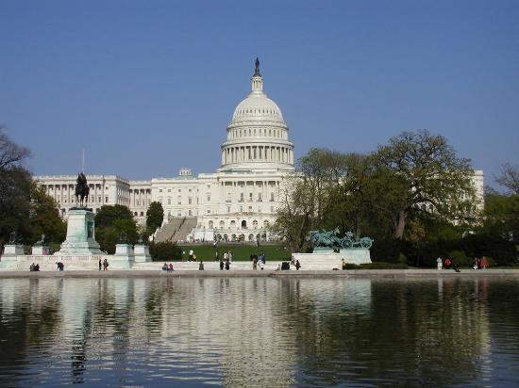
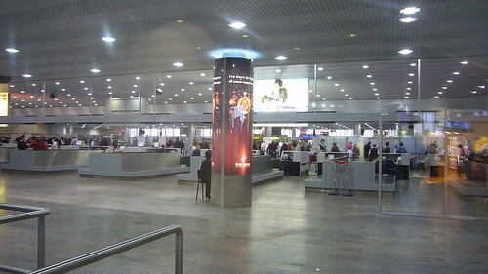

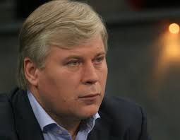



The Problem: User Perspective
Edward Snowden Ask for Asylum In Russia (04 / 07 /2013)
2

Slide 3
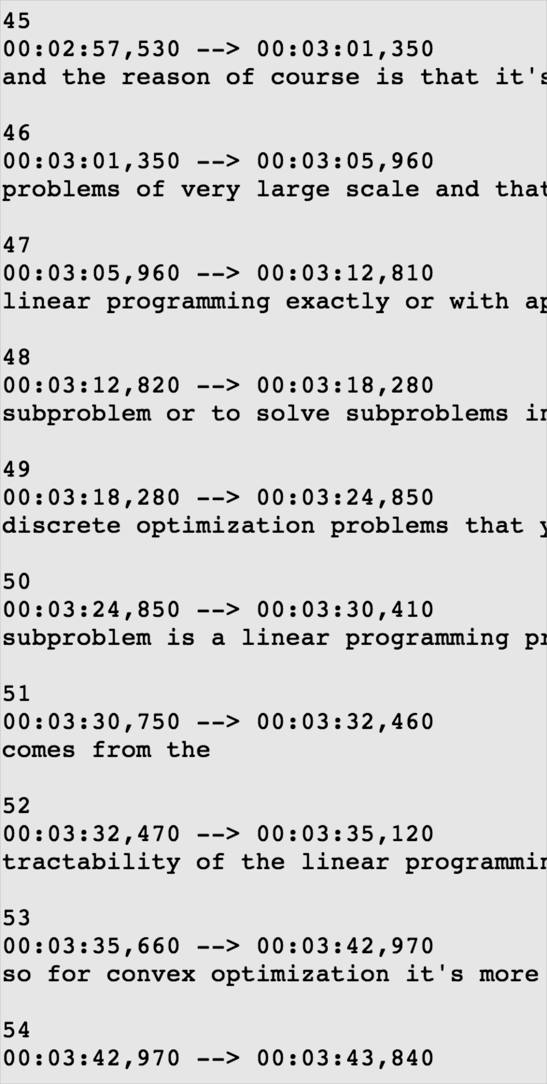
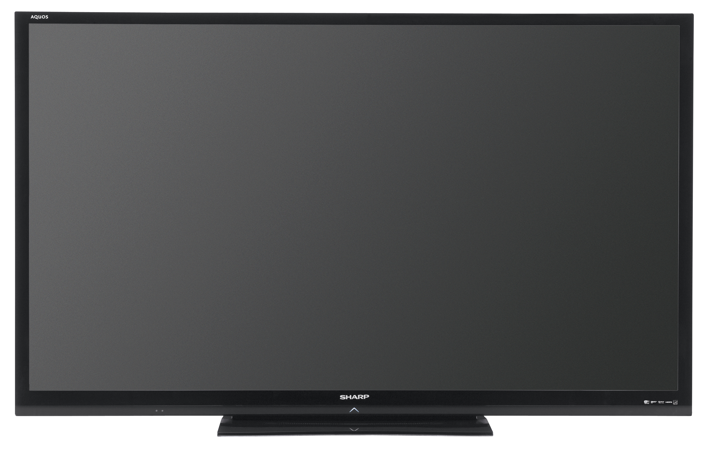
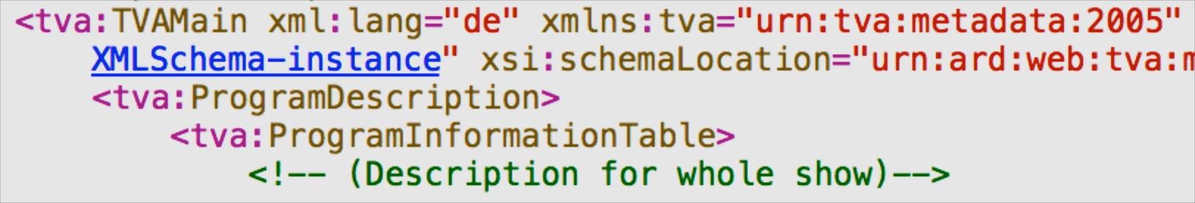


The Problem: Technological Perspective
In which russian airport is he exactly?
Solution: go out and grab it!
??
Subtitles
Metadata
OCR
Visual Cues
LSCOM:Face
LSCOM:Building
3

Slide 4
The Approach
a) Entities from Video
e_{a}
e_{b}
e_{c}
e_{d}
Event Entity Context:
List of Relevant Named Entities
(1) Named Entity Expansion
b) Expanded Entities
e_{a}
e_{b}
e_{c}
e_{d}
e_{f}
e_{g}
e_{h}
e_{i}
e_{j}
e_{k}
e_{l}
e_{m}
(2) DBpedia Filtering and Ranking
b) Re-ranked Entities
e_{a}
e_{c}
e_{h}
e_{j}
e_{k}
e_{m}
4

Slide 5
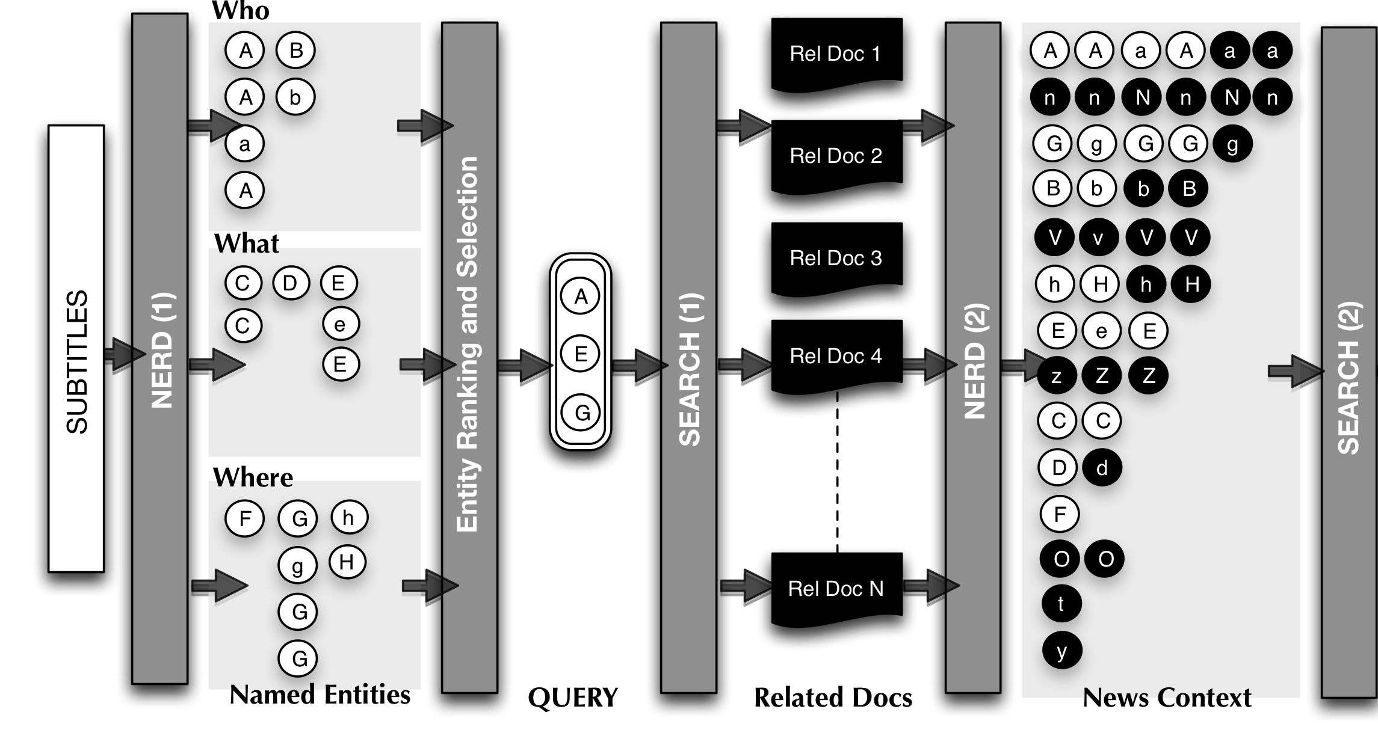
Named Entity Expansion
5

Slide 6











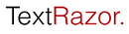




Named Entity Expansion
ontology¹
REST API²
UI³
¹ http://nerd.eurecom.fr/ontology
² http://nerd.eurecom.fr/api/application.wadl
³ http://nerd.eurecom.fr
6

Slide 7
Named Entity Expansion
Five W´s * ➔ Four W´s
Who?: nerd:Person, nerd:Organization
What?: nerd:Event, nerd:Function, nerd:Product
Where?: nerd:Location
When?: from Newscast’s metadata
Entity Ranking and Selection:
Ranking according Extractor’s Relevance
Relative Relevance falls in the upper quarter interval
Final Query:
Concatenate Labels of the selected entities in Who, What, Where, for a time t
(*) J. Li and L. Fei-Fei. What, where and who? classifying events by scene and object recognition.
7

Slide 8

Named Entity Expansion
Query
8

Slide 9
Named Entity Expansion
Entity Clustering:
Centroid-based approach.
Distance metric:
Strict string similarity over the URL’s
Jaro-Winkler string distance over labels.
Entity Re-ranking according to:
Relative frequency in the transcripts
Relative frequency over the additional documents
Average relevance from extractors
Outcome:
Frequent entities are promoted
Not disambiguated Entities can obtain a URL by transitivity
Same happens with erroneous labels
Relevant but non spotted entities arise (Example: N)
9

Slide 10
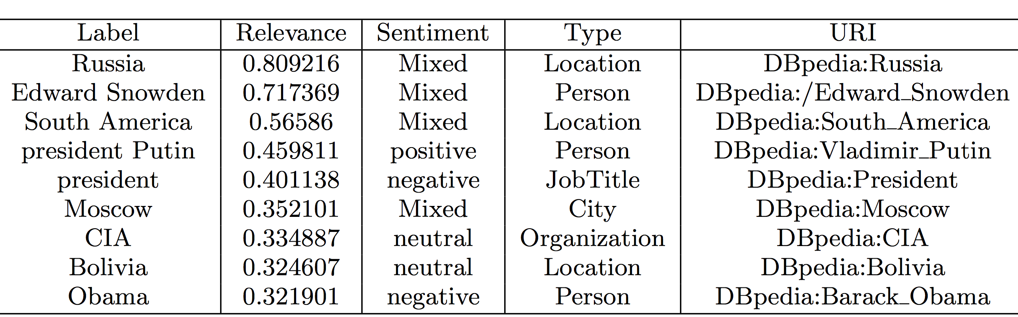
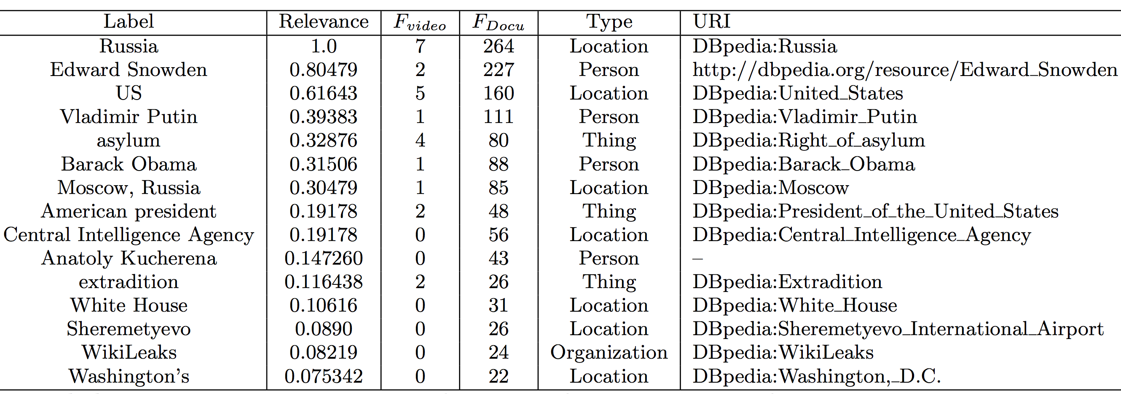
Named Entity Expansion: Results
Named Entity Expansion
➔
➔
➔
➔
✚




✚
✚
✚
✚
✚
✚
10
Notes:
REMINDER: Labels are better after the expansion, for example: Vladimir Putin

Slide 11
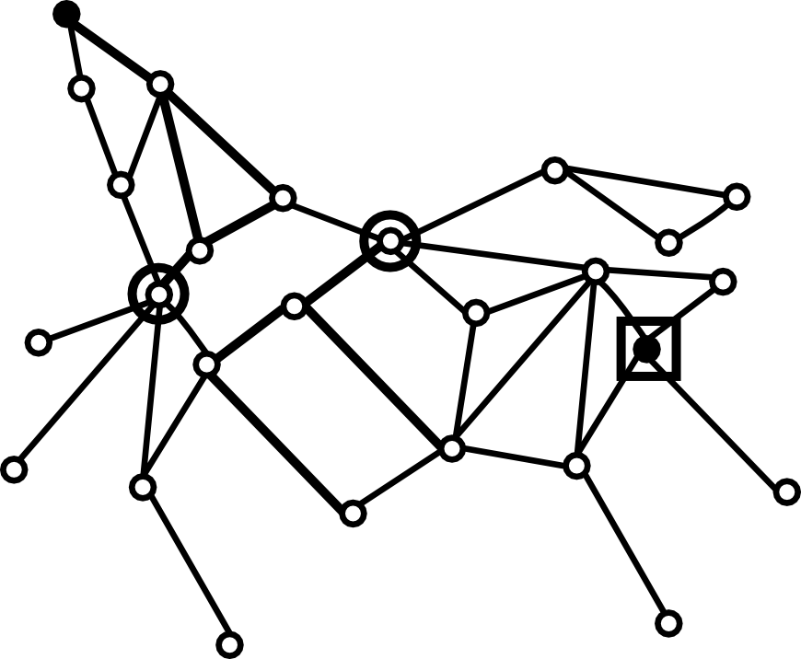
Refining via EiCE
For each pair of results:
Iterative generating DBpedia paths using EiCE [1].
: Barack_Obama
:Vladimir_Putin
[1] http://github.com/mmlab/eice

Slide 12
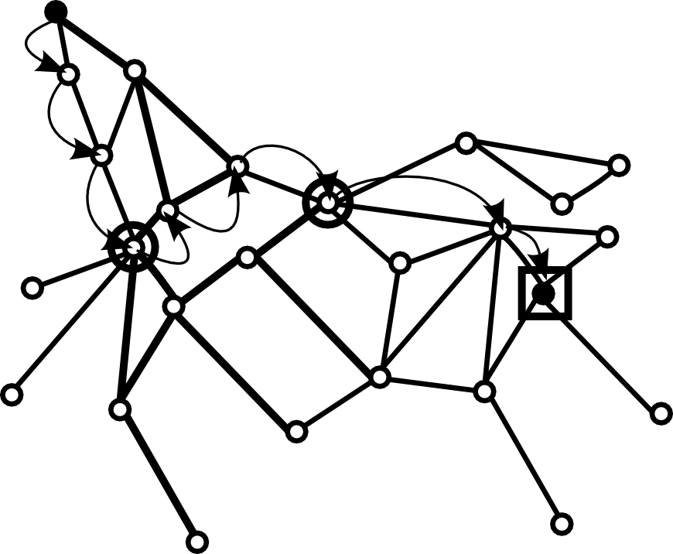
Refining via EiCE
Computing of initial path:
Preferring links with lower weight first (thinner lines)
: Barack_Obama
:Edward_Wilmot_Blyden_III
:United_States
:Vladimir_Putin
Path 1 = Barack Obama – Abdul Kallon – Freetown – United States - Edward_Wilmot_Blyden_III – Russia Vladimir_Putin

Slide 13
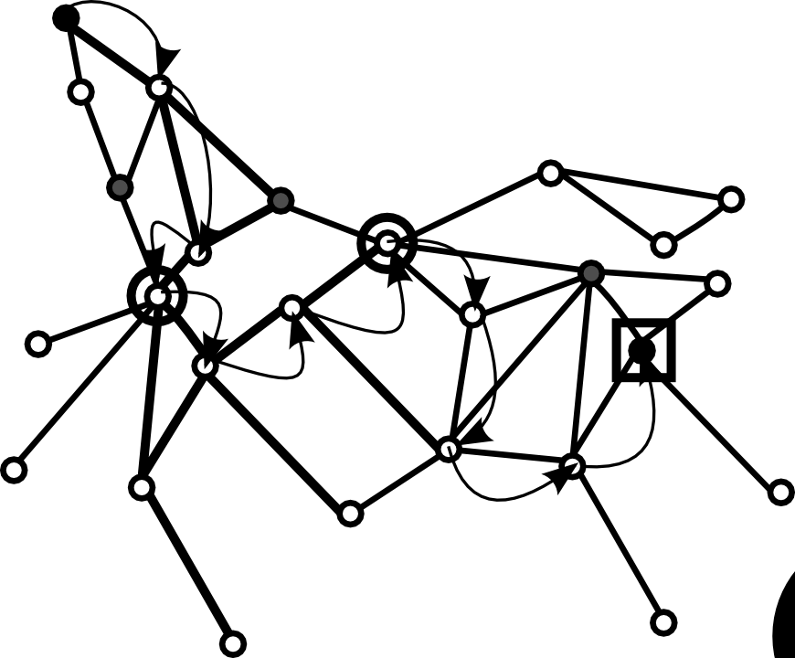
Refining via EiCE
Visited nodes being ignored in next iteration.
: Barack_Obama
:Columbia_University
:Edward_Wilmot_Blyden_III
:Abdul_Kallon
:Russia
:United_States
:Vladimir_Putin
:NewYork
.
:United_States
:Independent
_(politician)
:New_York_City
(leader)
Path 2 = Barack Obama – Columbia University – United States – New York City– New York City(Leader) – Independent Politician -Vladimir_Putin

Slide 14
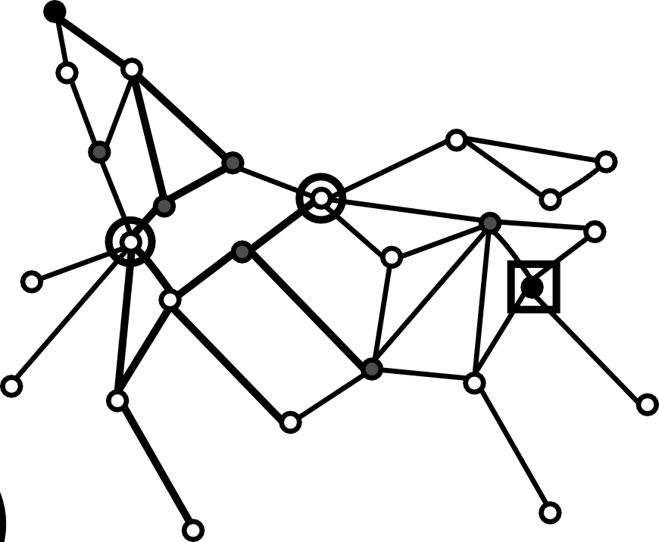

Refining via EiCE
Iterating continues until no more paths can be found.
: Barack_Obama
:Vladimir_Putin

Slide 15
Refining via EiCE
Computation of the average path lengths after k iterations:
Length(Path 1) = 6
Length(Path 2) = 7
…
Length(Path k) = n
____________________________________________________________________________________________
Average_Length (:Barack_Obama, :Vladimir_Putin) = (13 + … + n)/k
Distance (:Barack_Obama, :Vladimir_Putin) (*) = normalize (Average_Length)
…
…
_____________________________________________________________________
Adjacency Matrix (**)
(*) http://demo.everythingisconnected.be/estimated_normalized_distance
(**) http://demo.everythingisconnected.be/estimated_normalized_distance_matrix

Slide 16
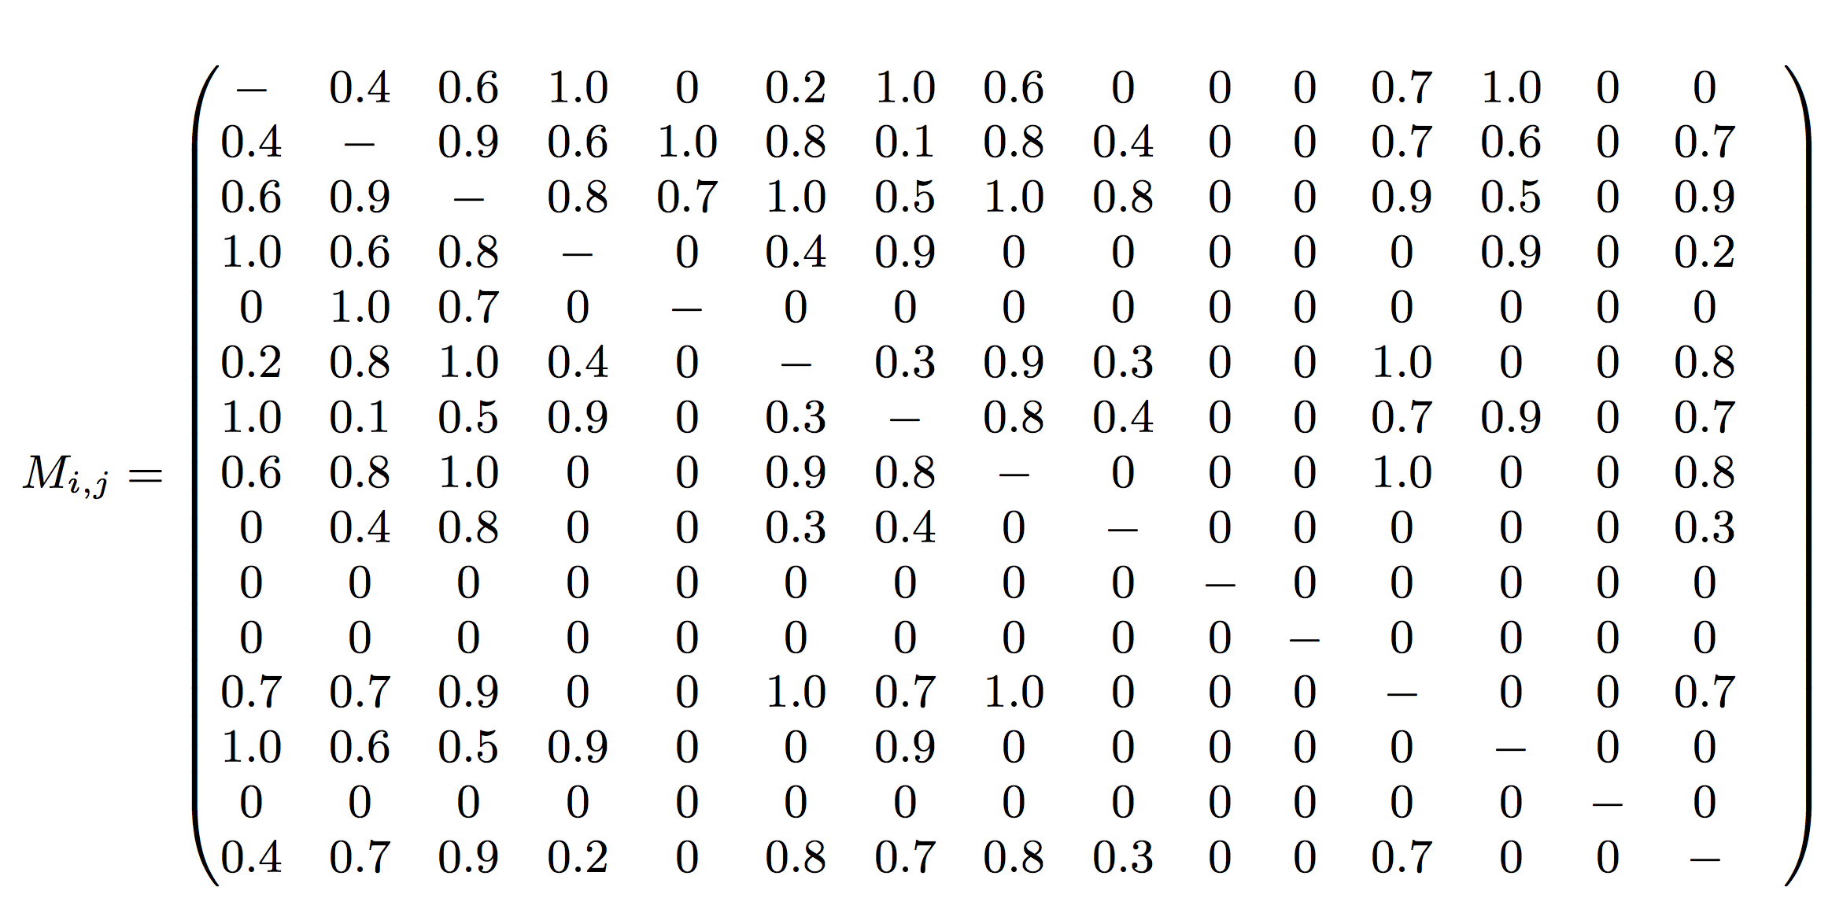
Refining via EiCE: Adjacency Matrix
..
Context Coherence
Wikileaks
Kucherena
Sheremetyevo
Adjacency Matrix M_{i,j}
D(e_{i} ,e_{j}) =Avg(lenght(Paths(e_{i}, e_{j} ))))
16

Slide 17
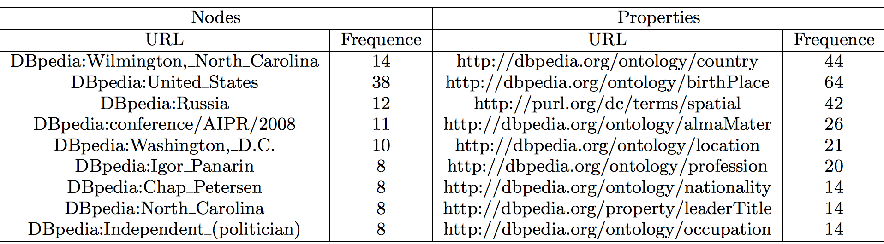
Refining via EiCE: Results
..
Frequent Nodes and Properties
⬅

⬅

⬅
⬅

⬅
⬅
⬅
⬅
⬅
Some frequent classes already detected are further promoted!!
In the context of the newscast, Geographical and political matter!!
17

Slide 18
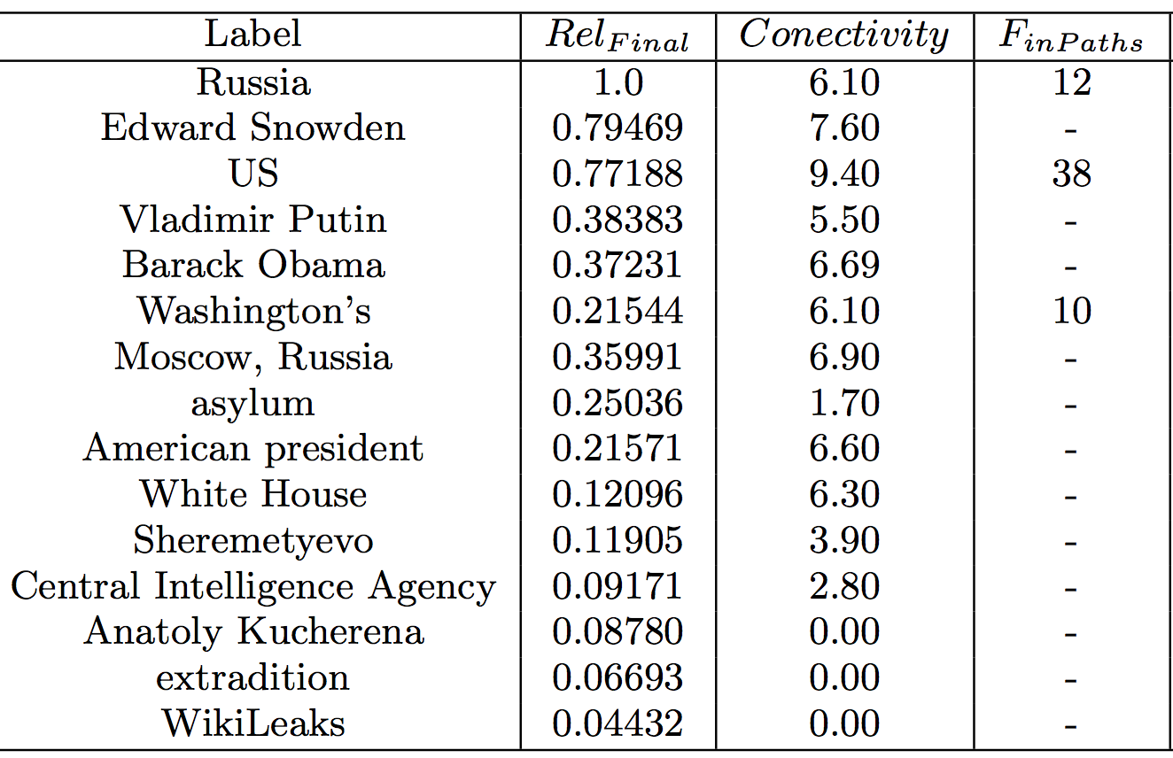
Refining via EiCE: Results
..
NE Expansion
DBPedia Clues
➔
➔
(2) Dbpedia Ranking
➔
➔


➔








18

Slide 19
Evaluation: Edward Snowden Asylum
..
Set up: Expert defines the list of relevant concepts for the newscast based on a deep analysis of the main argument and the feedback of 8 users participating in a user experience study [*]
GT Entity | Expert’s Comment | NE Extraction | NE Expansion | DBpedia Clues
Edward Snowden | Public figure. He is the “who” of the news | ✔ | ✔ | ✔
Russia | The location, but also an actor, the indirect object of the main sentence “”to whom” | ✔ | ✔ | ✔
Political Asylum | This is related to the “what” of the news. This is the Snowden’s request, the direct object. |  | ✔ | ✔
CIA | Background information on related to Snowden, since he is an ex-CIA employee. An axe in a wider sense, not this item in particular, but on Snowden’s history. | ✔ | ✔ | ✔
Sheremetyevo | Airport, specific location of the news |  | ✔ | ✔
Anatoly Kucherena | Secondary actor and speaker in the video. Information about an interview of person expressing his opinion. |  | ✔ | ✔
US Department of State | Involved organization. Not mentioned but related with the main subject
Other Entities |  |  | “human-rights” and “extradition” | Minister of Russia, “Igor Shuvalov”
Other Comments |  |  |  | Better ranking: Entities like “Sheremetyevo” scored higher
[*] L. Perez Romero, R. Ahn, and L. Hardman. Linkedtv news: designing a second screen companion for web-enriched news broadcasts.
19

Slide 20
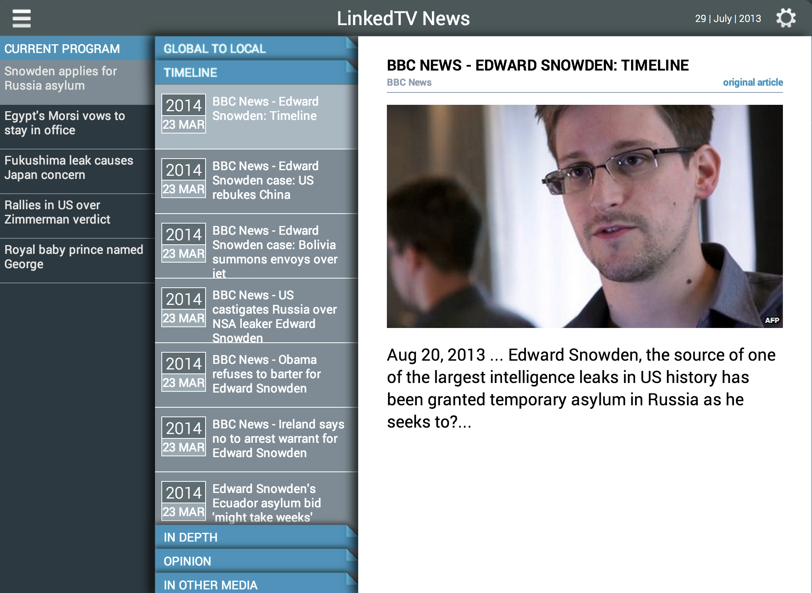
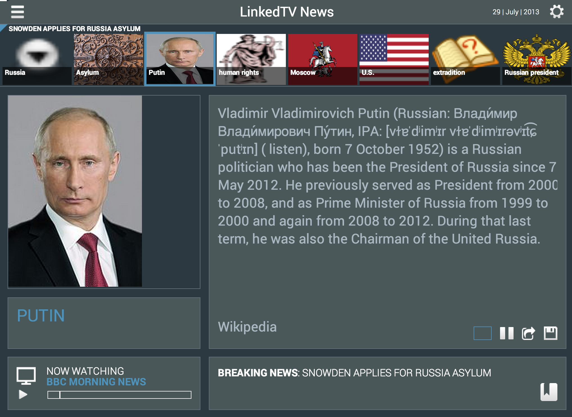
Feeding a companion TV app
Main Screen @
http://linkedtv.project.cwi.nl/news/mainscreen.html
Second Screen @
http://linkedtv.project.cwi.nl/news/
20

Slide 21
Conclusions
Approach for context-aware annotating News Events:
Starts from named entities recognized in timed text
Expands this set by analyzing additional documents about the same event
Completes with cues about the path connectivity in DBpedia
Preliminary results indicate that:
The initial set of entities is augmented with relevant concepts not detected by pure NE approaches
By exploring DBpedia paths we:
Obtain a more accurate ranking of the relevant concepts
Bring forward more related entities
Filter out those that are not representative in the broader context of an event
The resultant Entity Context provides newscast applications with valuable data that enhance user experience

Slide 22
The Future
More extensive evaluation involving a bigger number of users and use cases
Regarding the NE Expansion:
Study the adequacy of different extractors in NERD when:
Annotating the original transcripts of the video. (Representative entities)
Annotating the additional documents found in the Web (Relevant Entities)
Optimizing query generation phase:
Exploit whole entities instead textual labels only
Regarding connectivity study in DBpedia.
Further analysis of relevant properties for promoting entities involved with them
Cluster algorithms over the Adjacency Matrix for detecting meaningful groups of entities.
Continuing developing user oriented applications for bringing value out of the resultant entity context

Slide 23
Contextualizing Events in TV News Shows
José Luis Redondo García, Laurens De Vocht, Raphaël Troncy,
Erik Mannens, Rik Van de Walle
{redondo, raphael.troncy}@eurecom.fr
{laurens.devocht, erik.mannens, rik.vandewalle}@ugent.be

